Slide 1

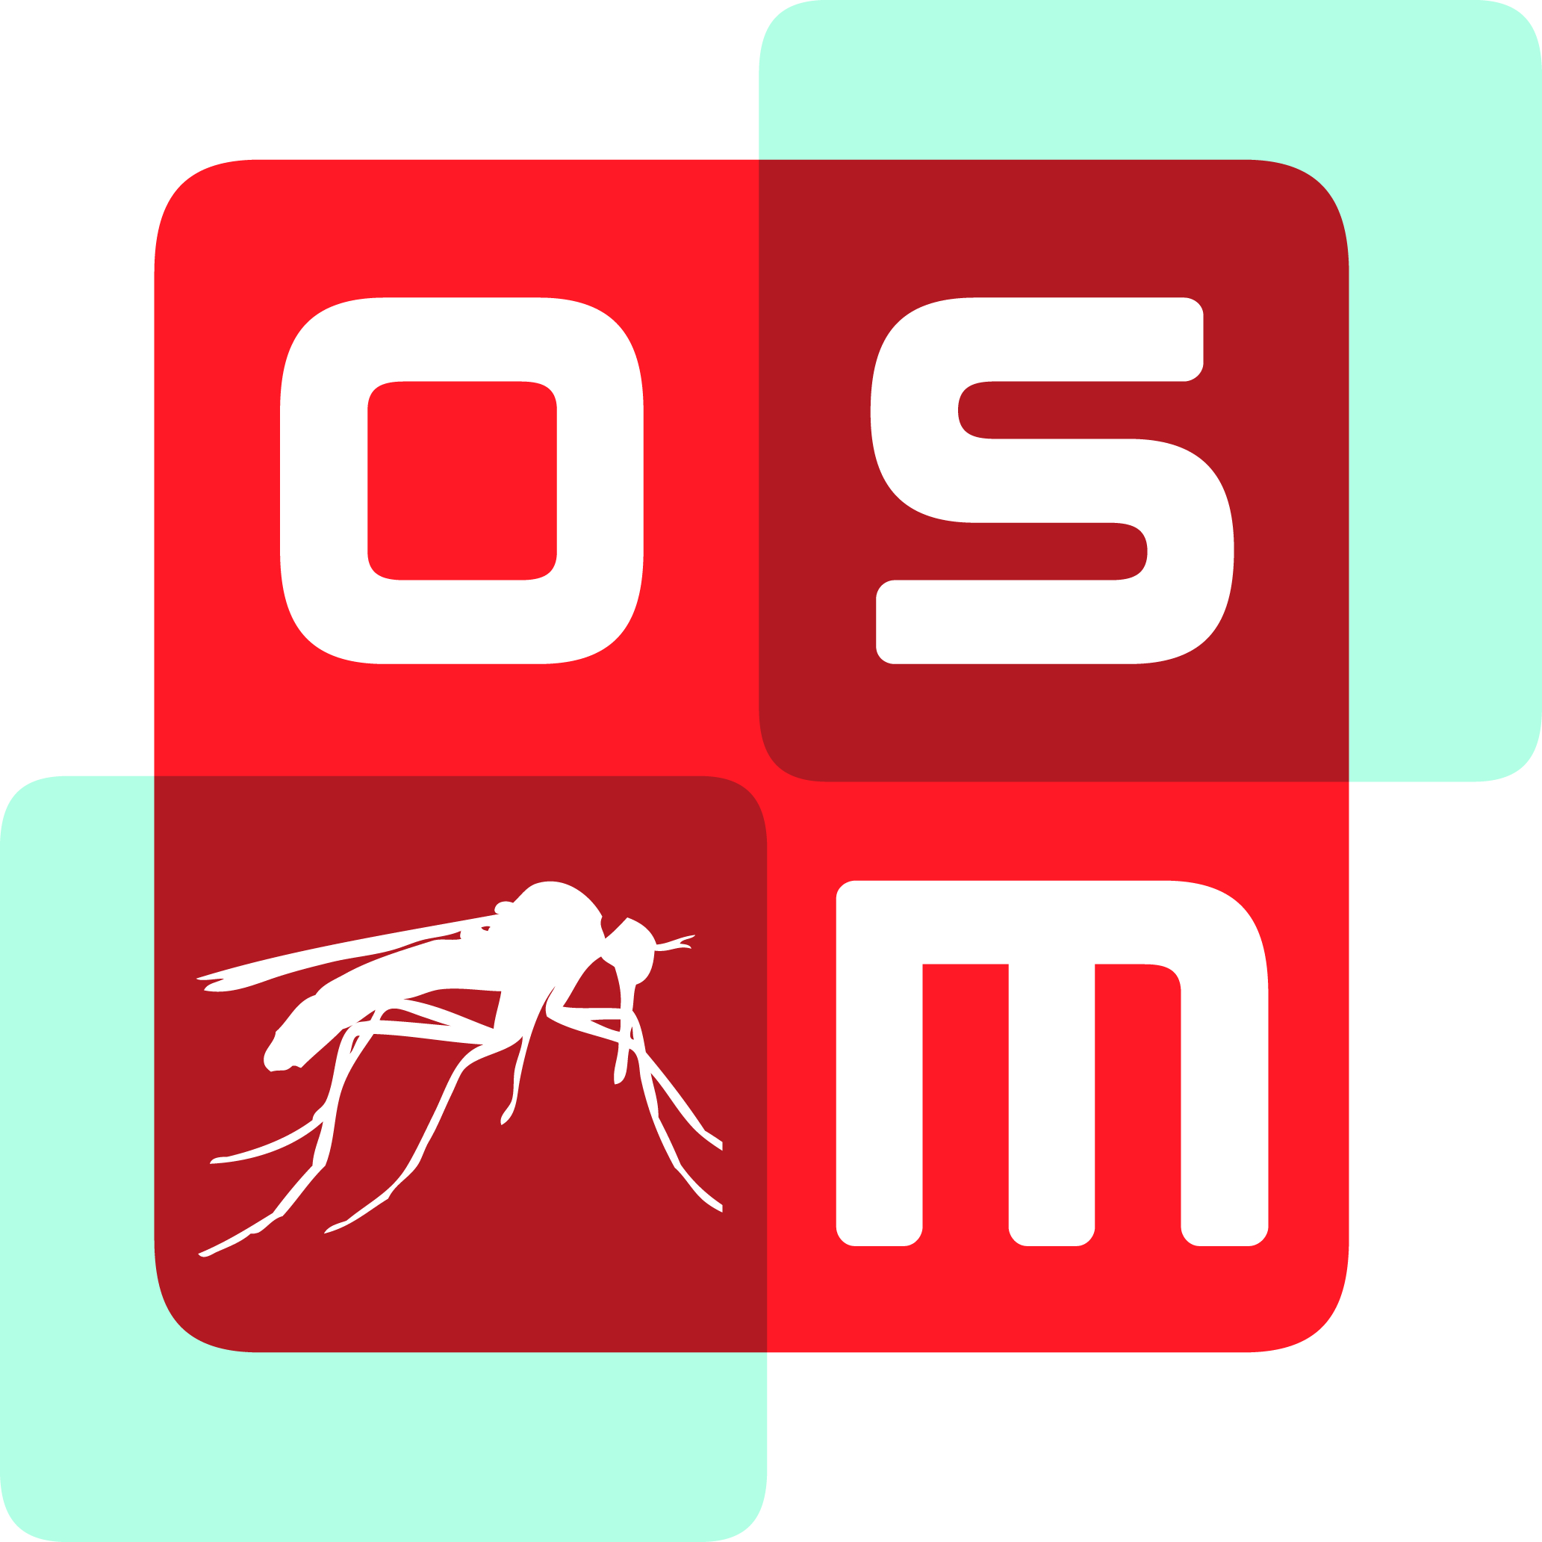
READDI-AC Kick-off, 9th Sept 2022
How Open Science Will Accelerate Lead Discovery in READDI-AC
Prof Matthew H. Todd
Chair of Drug Discovery, University College London
@mattoddchem
Some things we’ll cover:
What is “open source”?
How have we applied this to drug discovery?
How might this lead to new antivirals?
Why Do This?

Slide 2
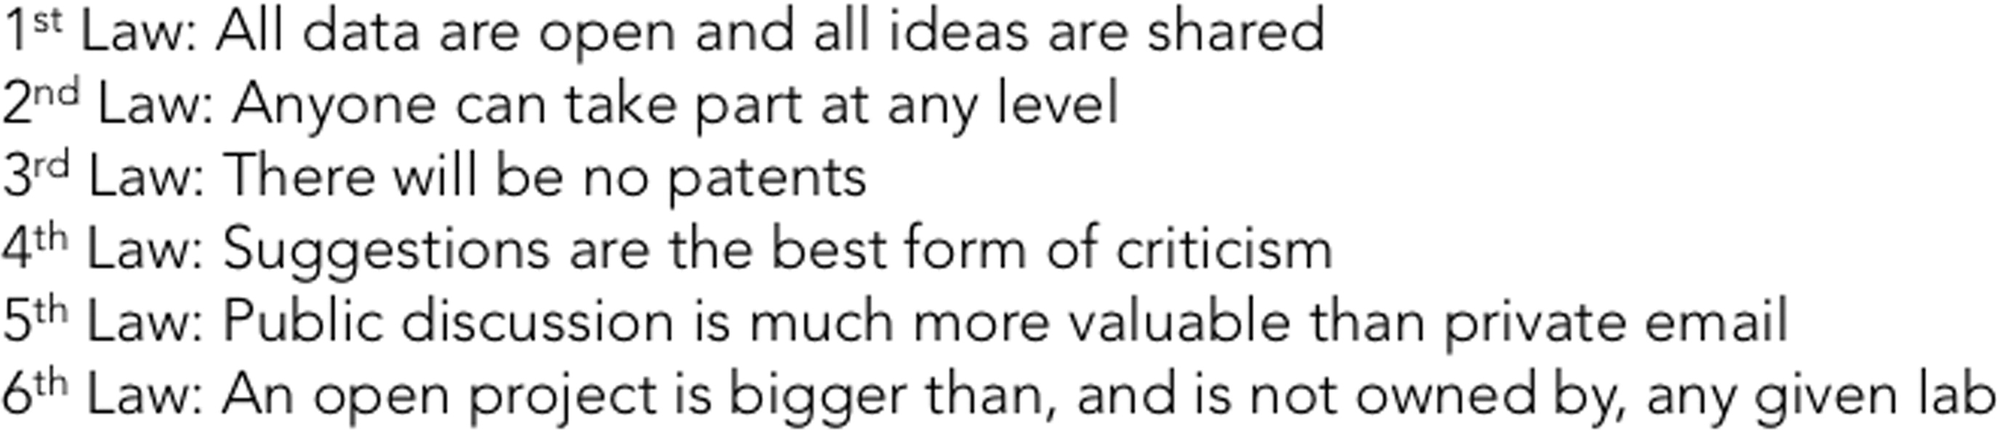
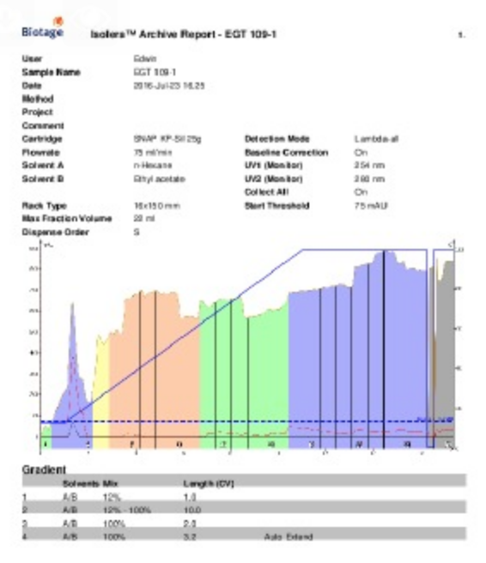
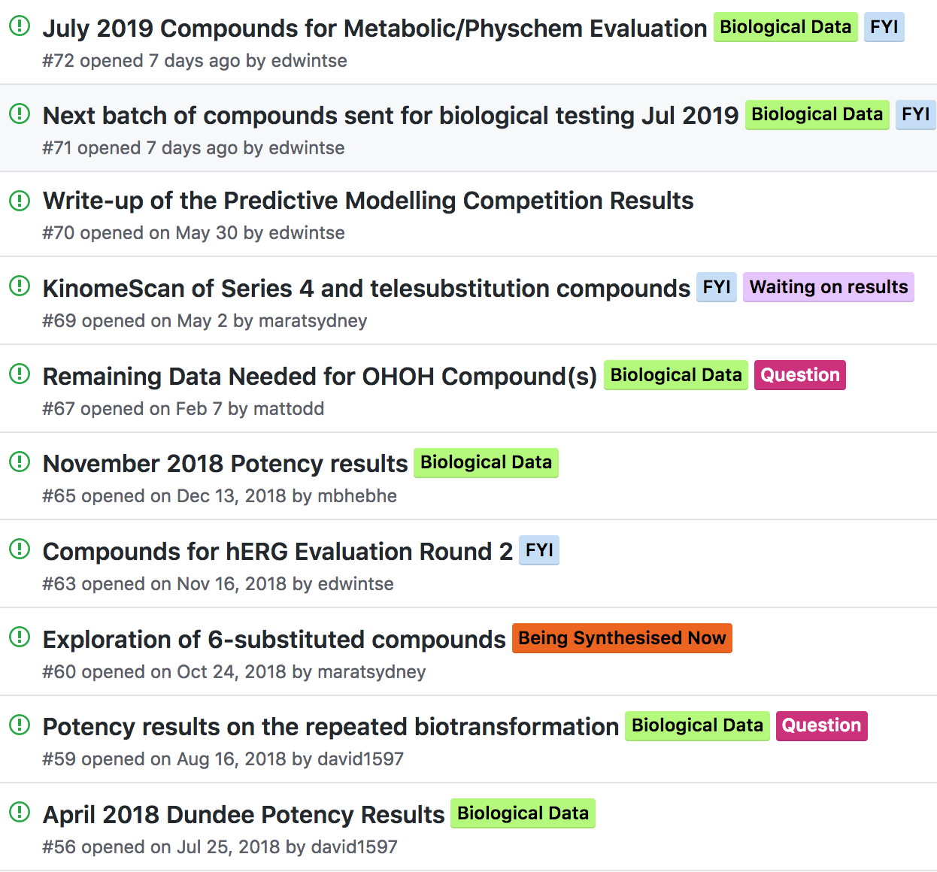
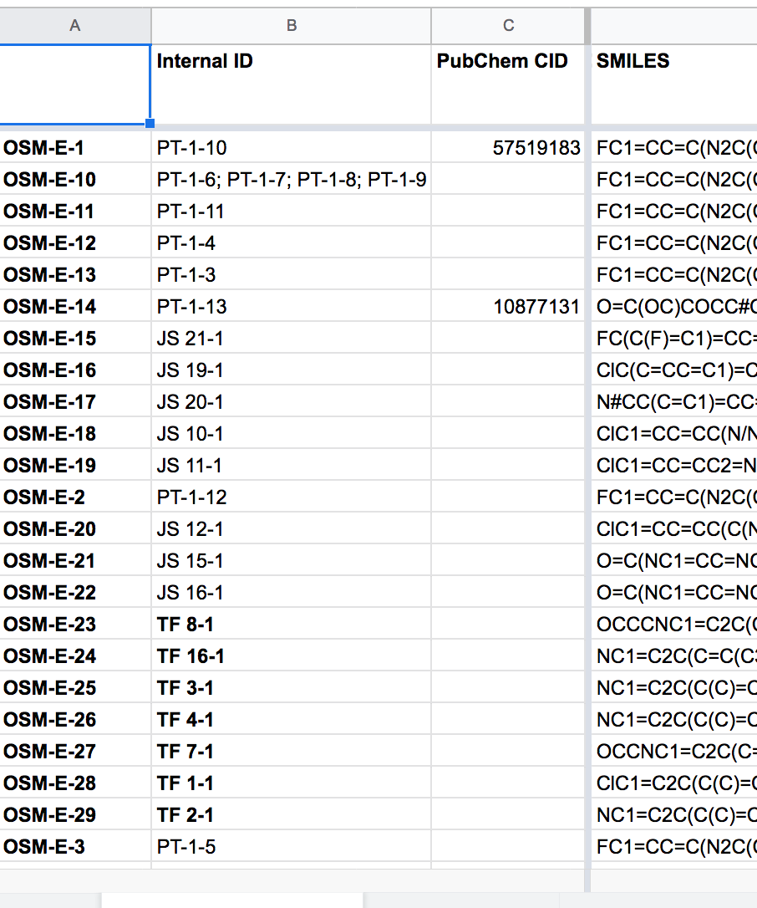
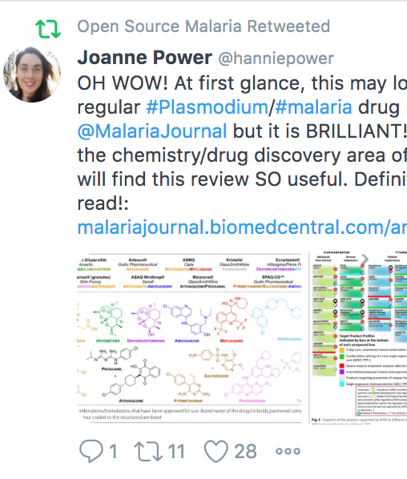
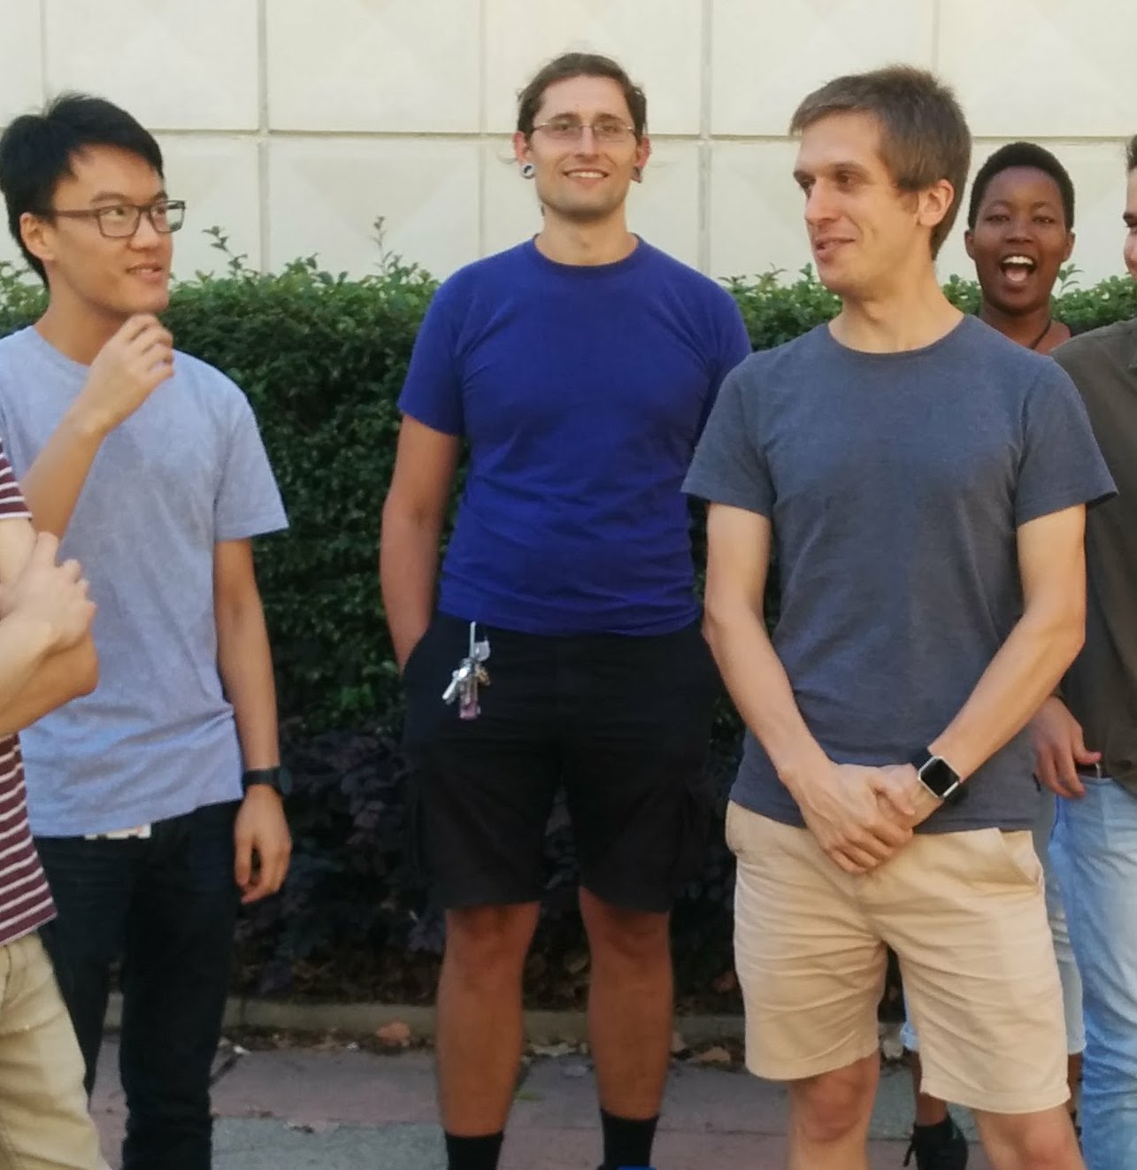
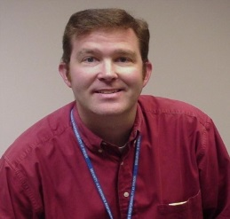
Open Source Drug Discovery: The Approach
2/20
Malaria: ACS Cent. Sci. 2016, 2, 687; J. Med. Chem. 2020, 63, 11585; J. Org. Chem. 2020, 85, 13438; J. Med. Chem. 2021, 64, 16450. TB: J. Med. Chem. 2018, 61, 11327. Antifungals: PLoS NTD 2018, 12(4): e0006437; PLoS NTD 2022, 16, e0010159. Platform: Chem. Sci. 2015, 6, 1614; Parasitology 2014, 141, 148. Laws: ChemMedChem, 2019, 14, 1804. Translation/Policy: PLoS Med. 2017, 14(4): e1002276; Wellcome Open Res. 2021, 6:146.
Components
Contributions
Laboratory Notebooks
Public To Do Lists/Discussion
Open Data
Community
Students
Pharma

Slide 3
Some “Open”s
3/20
Open Access – to read
Open Data – to re-use
Open Innovation – to … what?
Open Source – all that, and to participate

Slide 4
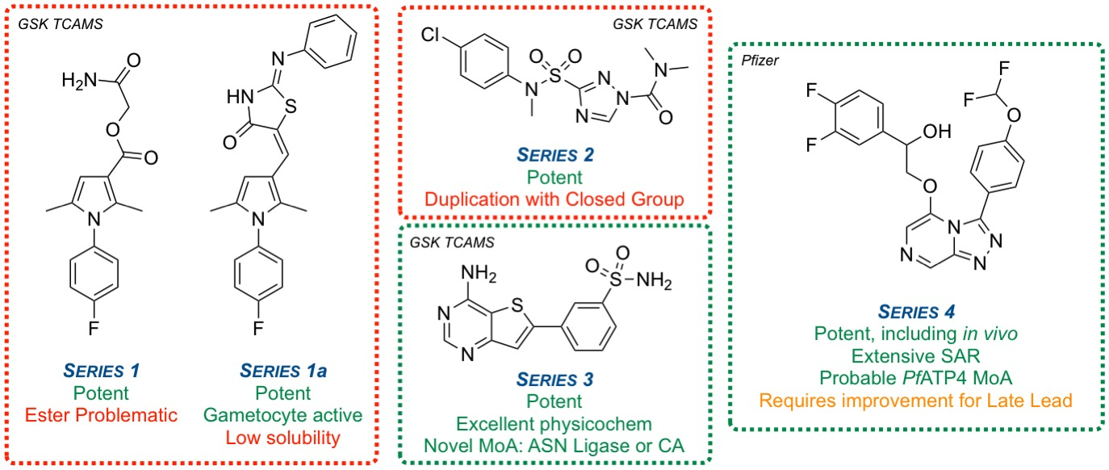
Open Source Malaria, with MMV
4/20
Series typically not exhausted - Decision points made to move to another.
Anyone free to employ OSM infrastructure to explore these, or other, series
www.opensourcemalaria.org, @O_S_M

Slide 5
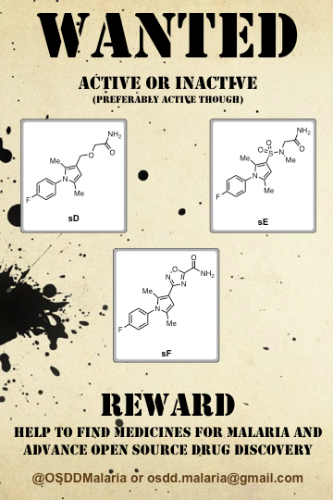
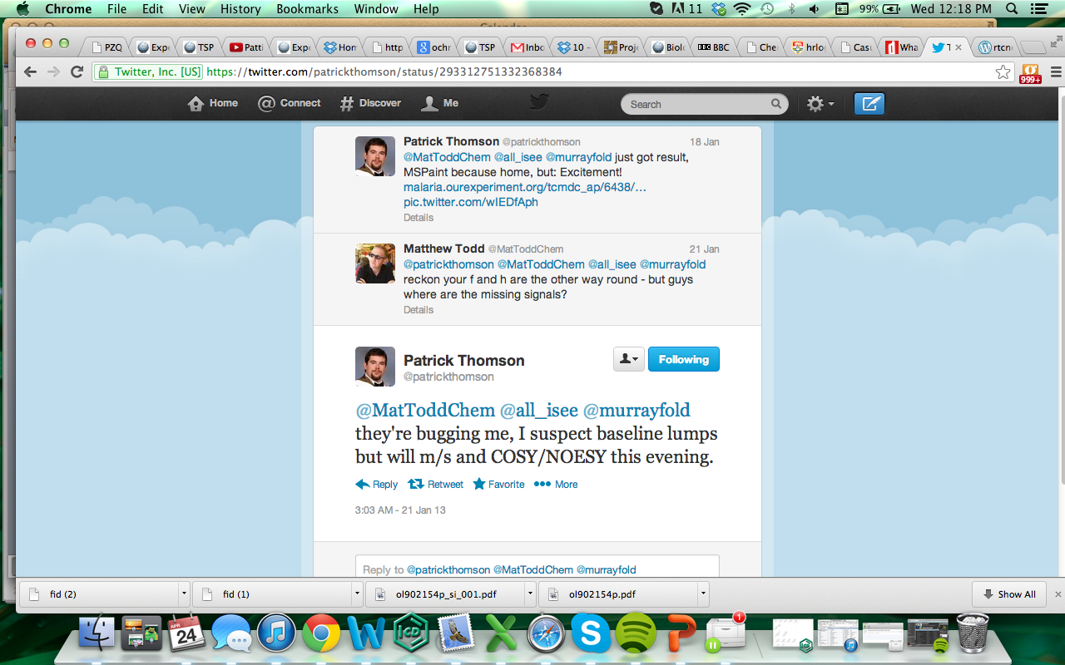
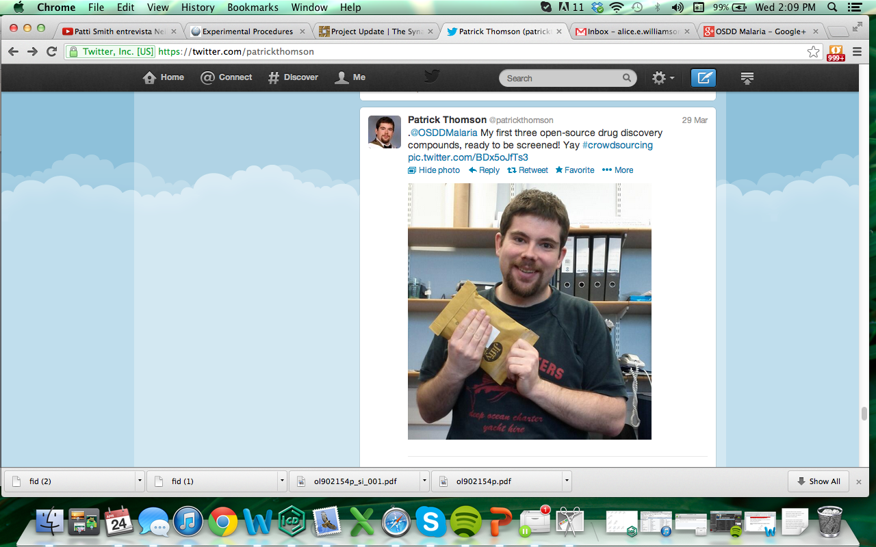
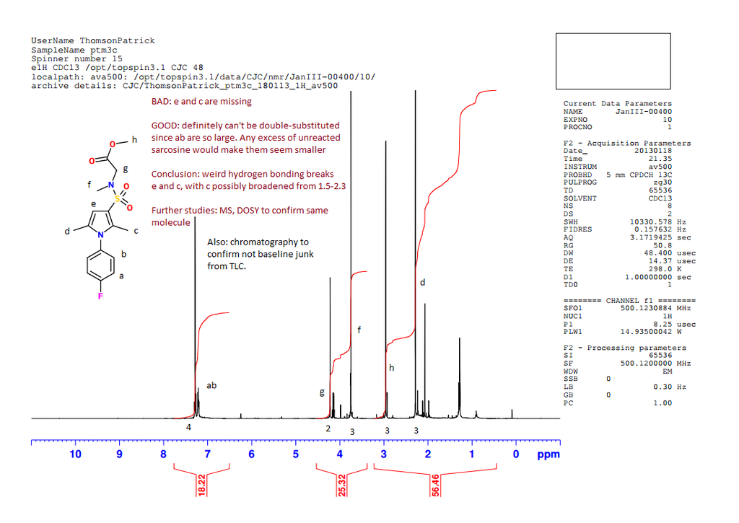
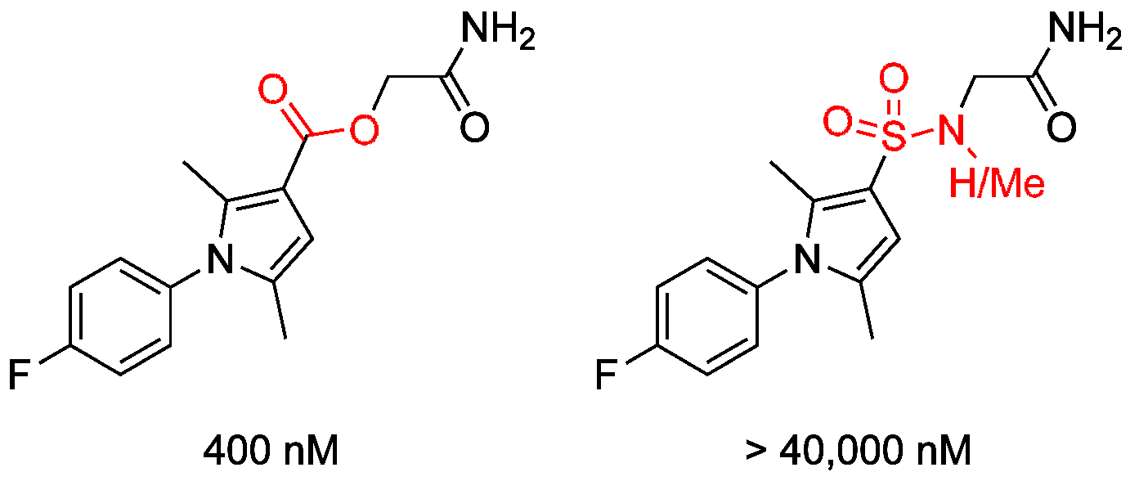
Example of Spontaneous Input
5/20

Slide 6
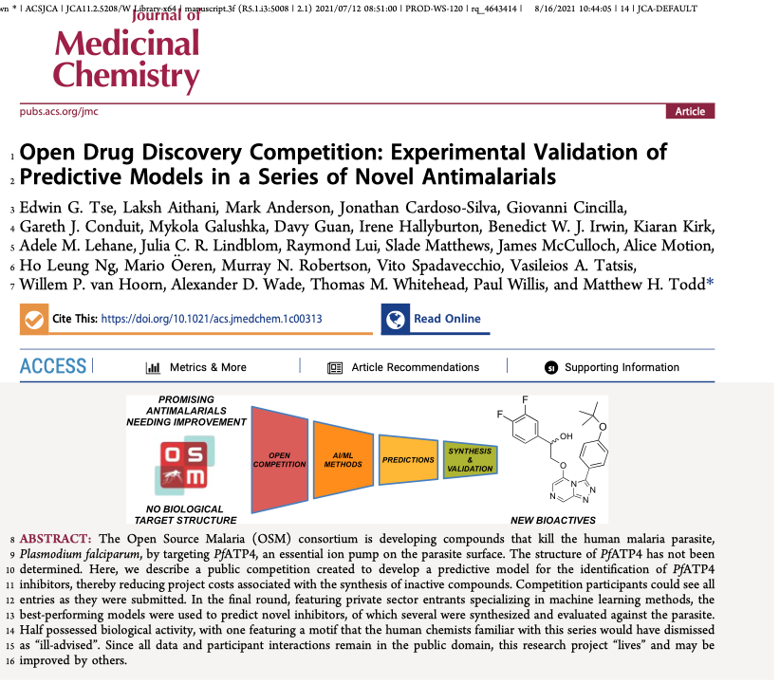
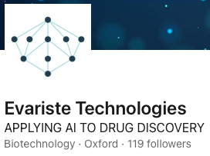
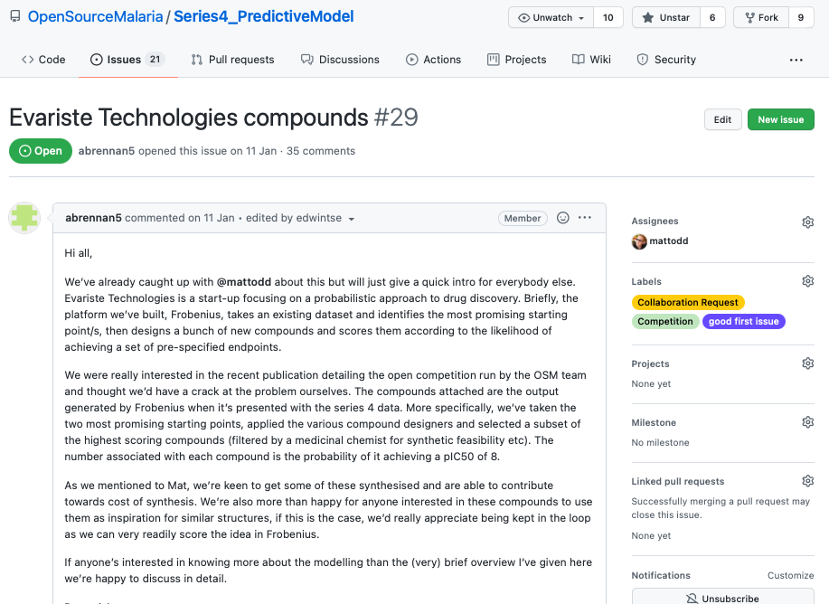
6/20
Open Science Leads to Quality Inputs, Especially from Industry
We rediscover this each time we run a project
J. Med. Chem. 2021, 64, 16450-16463. DOI: 10.1021/acs.jmedchem.1c00313

Slide 7
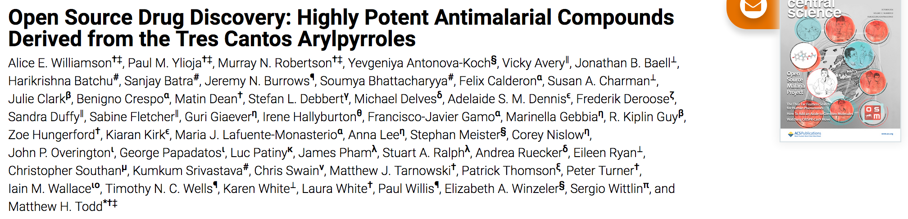
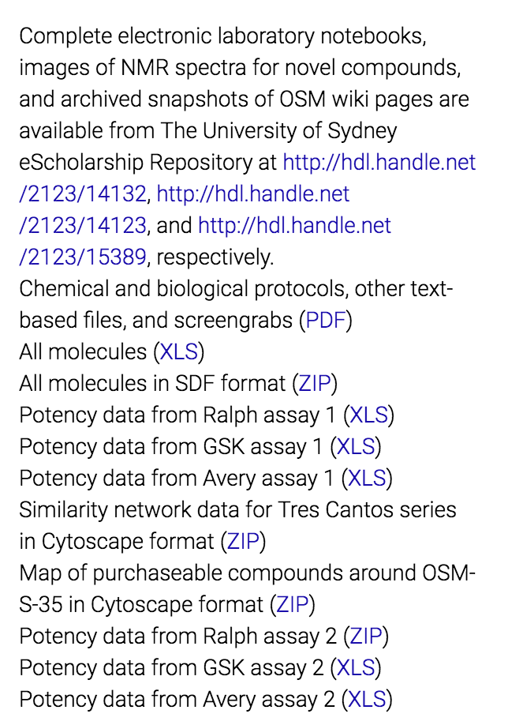
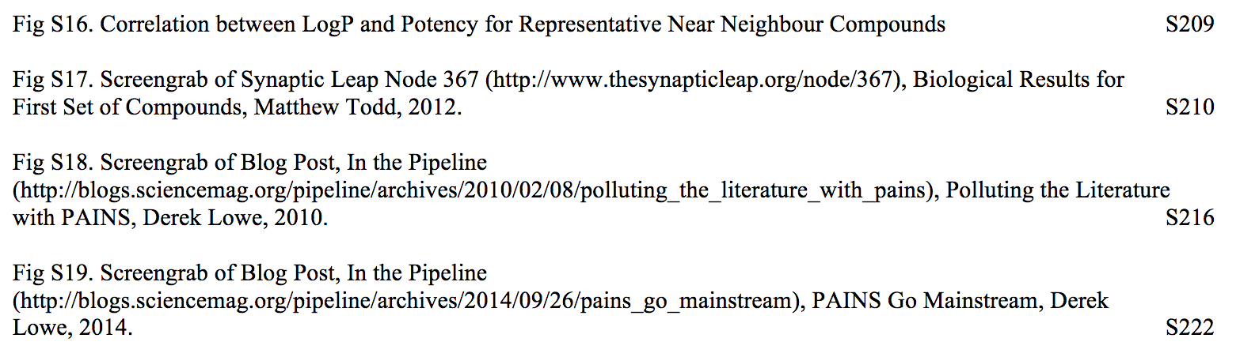
7/20
Publish As Normal

Slide 8
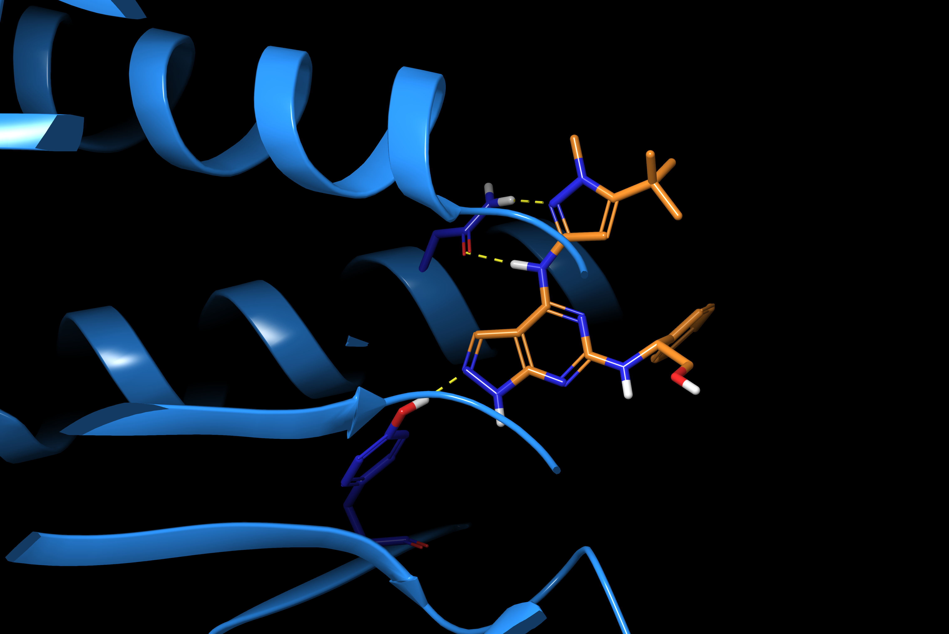


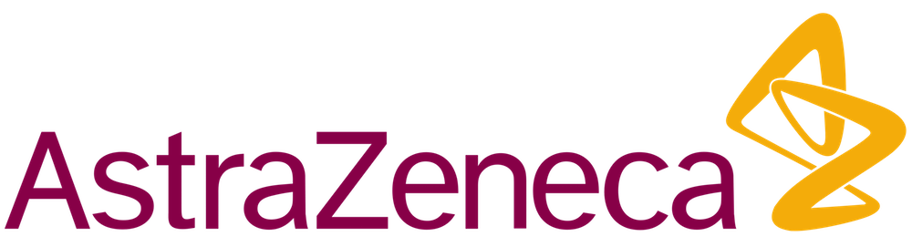
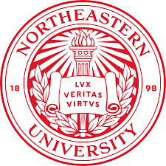
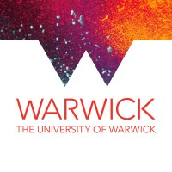
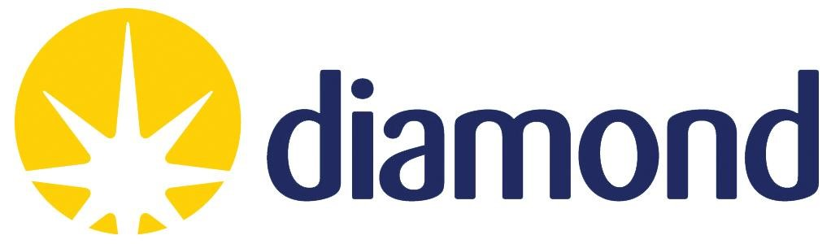



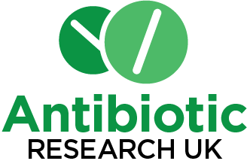
8/20
Open Source Antibiotics – Core Leverages More
CORE
PRO BONO
SYNTHESIS
SAMPLES/EXPERTISE
CRYSTAL TRIALS
EXPERTISE
MurC – AZ inhibitor, Sept 2020
ENZYMOLOGY
FRAGMENTS
AI/ML
92 NEW SAMPLES
INFORMATICS
New: Three new small molecules inhibiting more than one mur ligase.
This ”multi-targeting” means emergence of resistance is less likely.

Slide 9
9/20
Example of Workflow from Breaking Good
“Special Studies Program” at The University of Sydney
Ca. 50 students per cohort, about 8 weeks.
Supervised by grad students who help with things that are hard in research lab
With Alice Motion, Ed Tse, Marat Korsik, Peter Rutledge
(see also Bill Scott’s Distributed Drug Discovery, e.g. ACS Chem. Biol. 2020, 15, 3187)

Slide 10
10/20
Peer-to-peer work, and Unexpected Contributions
Prof Japan
Prof England
Prof Ghana
Student England
Student Japan
Student Ghana
Prof India
Apparent Project Boundary
Member of Public US

Slide 11
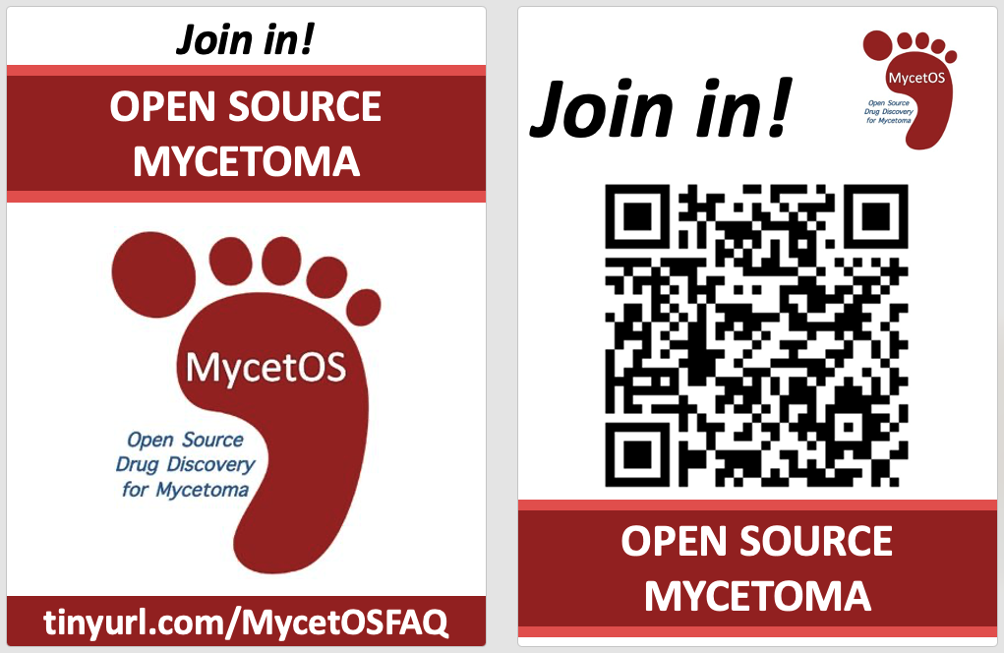
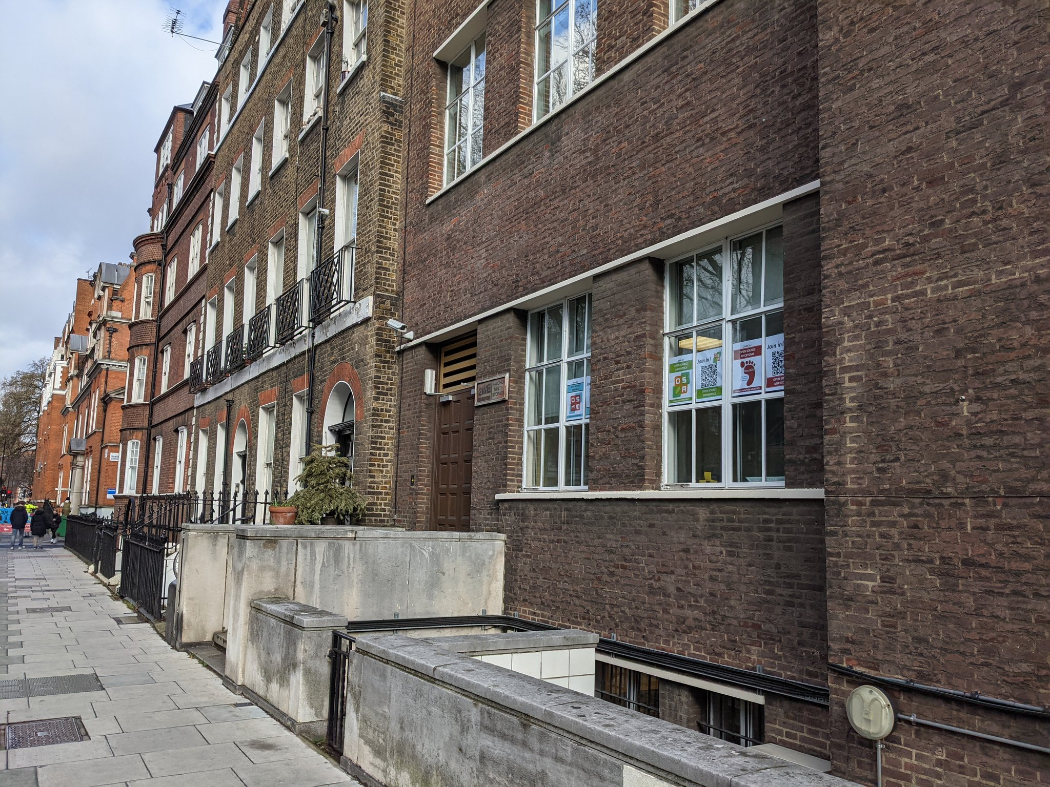
11/20
May Need to Get Creative with Advertising

Slide 12
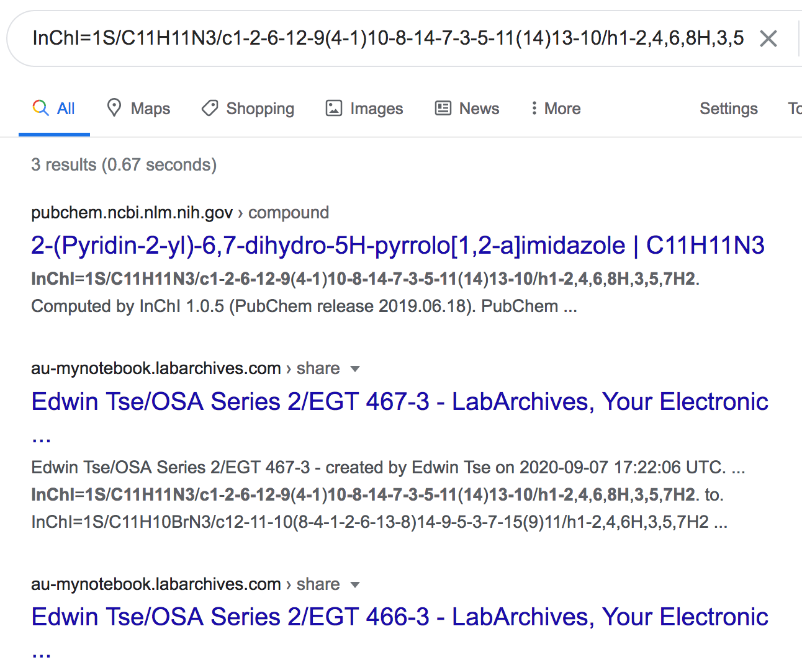
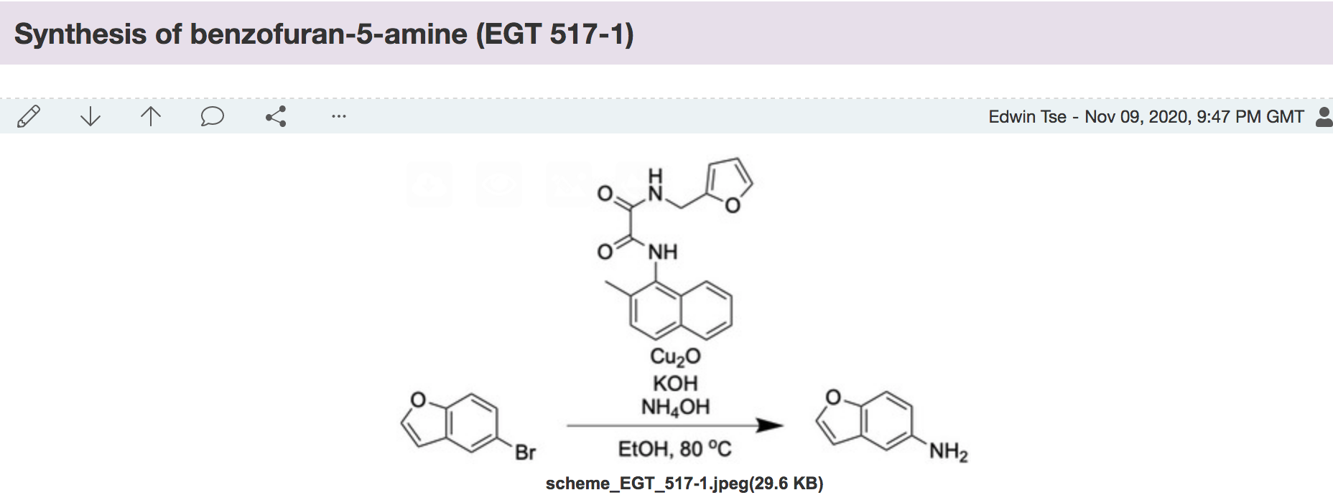
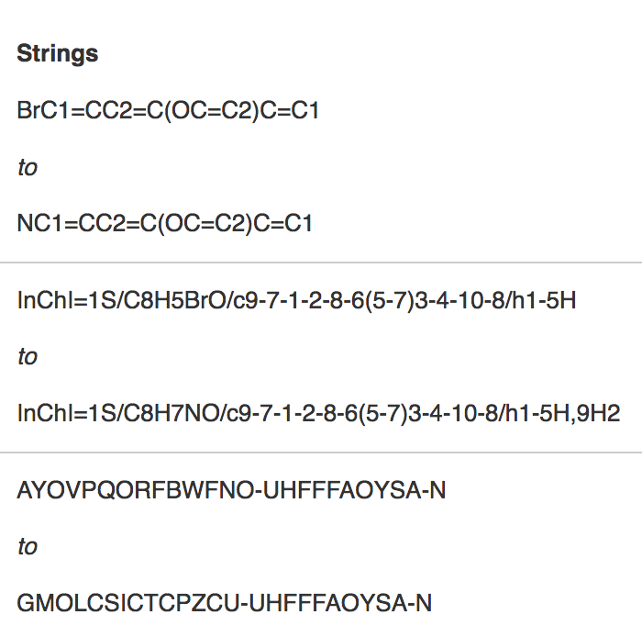
12/20
Simple Technologies Help Dramatically with Discoverability
Public Lab Notebooks and Other Data Tools are Available, but Under-used. They’ll grow.
Discoverable
Machine-Readable

Slide 13
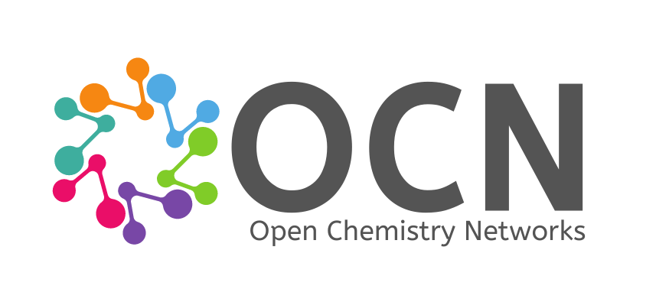
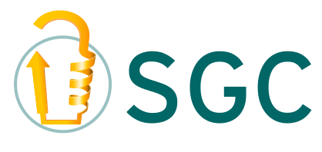
13/20
Applying what we know to a big project: Target2035

Slide 14
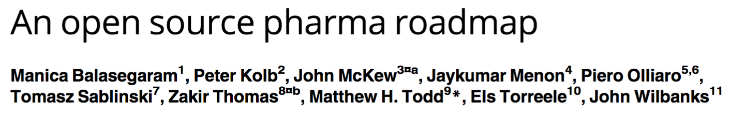
14/20
The Financial Solution to Translation Depends on the Disease
PLoS Med. 2017, 14(4): e1002276
Area 1
Who cares?
(e.g. mycetoma)
Area 2
Current Pharma Sweetspot
(e.g. diabetes)
Area 3
Pharma can’t easily act.
Might be money.
Business model useful.
(e.g. antibiotics, future antivirals?)

Slide 15
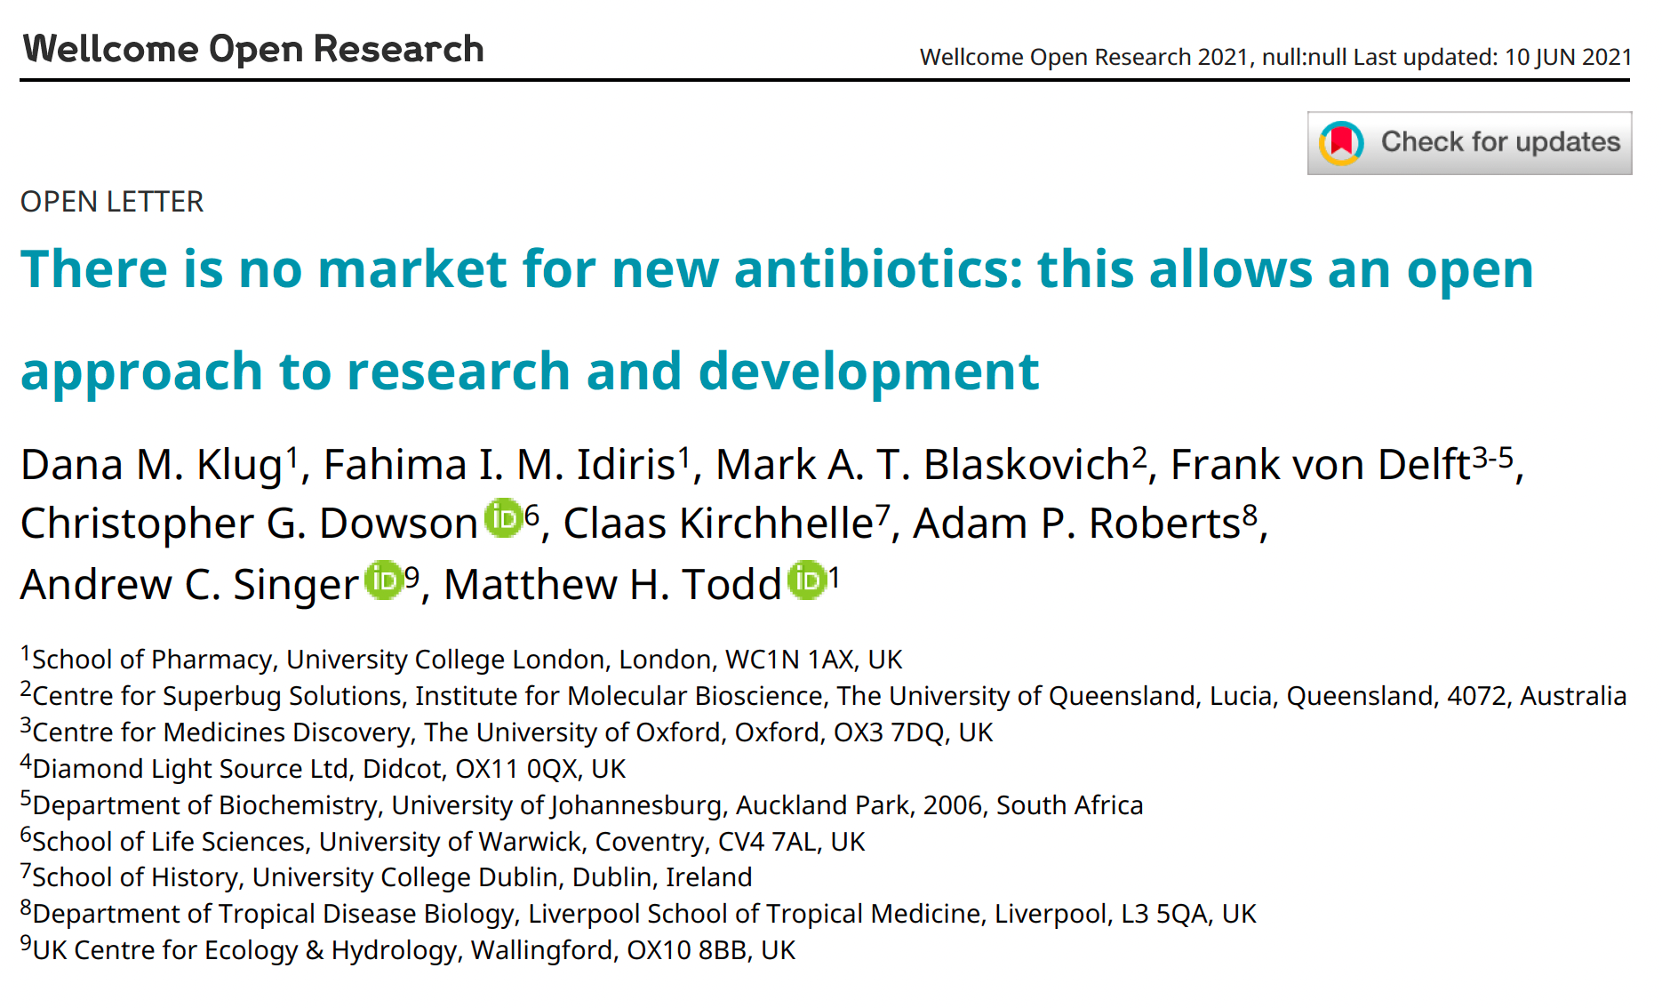
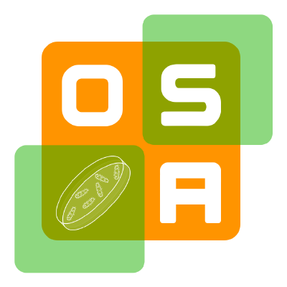
15/20
New $ Solutions for Antibiotics Could be Used for Open Drug Development
Open Source Antibiotics
@OSantibiotics

Slide 16
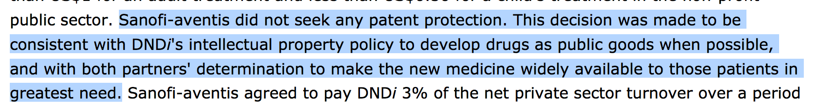
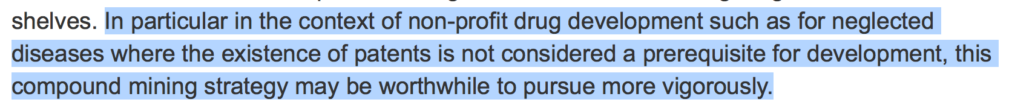
16/20
Open Means No Patents. Problem?
Penicillin, The Polio Vaccine
ASAQ/Coarsucam
Bompart F, Kiechel JR, Sebbag R, Pecoul B (2011) Innovative Public-Private Partnerships to Maximize the Delivery of Anti-malarial Medicines: Lessons Learned from the ASAQ Winthrop Experience. Malaria Journal 10:143. doi:10.1186/1475-2875-10-143
Fexinidazole
Torreele E, Bourdin Trunz B, Tweats D, Kaiser M, Brun R, Mazué G, et al. (2010) Fexinidazole – A New Oral Nitroimidazole Drug Candidate Entering Clinical Development for the Treatment of Sleeping Sickness. PLoS Negl Trop Dis 4(12): e923. doi:10.1371/journal.pntd.0000923

Slide 17
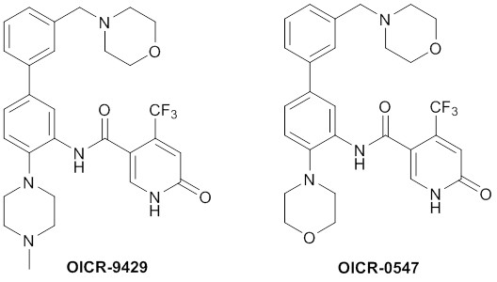
17/20
All Hit to Probe 100% Open, Providing Translational Options
A biological tool molecule (“probe”) can be converted into a drug (which is different)
Public domain tool for protein WDR5
→ $1Bn investment from Celgene to progress it towards a drug
https://www.thesgc.org/news/toronto/new-potential-treatment-leukemia-discovered-oicr-scientists-draws-major-industry

Slide 18
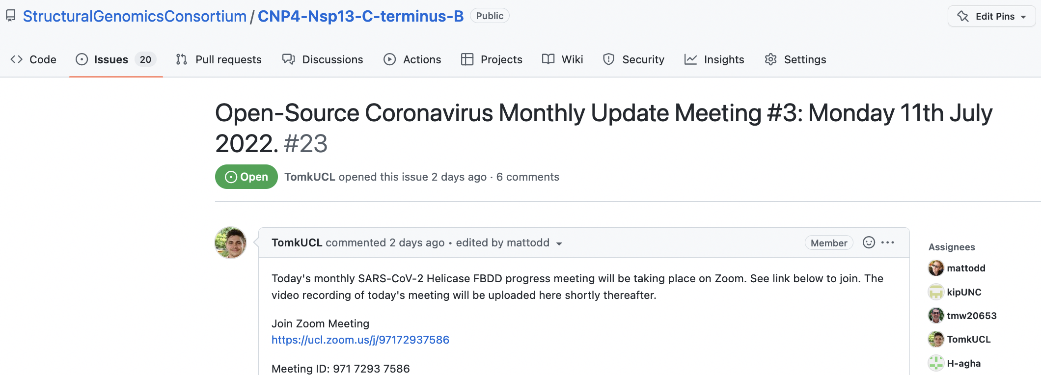
18/20
Example – The Nsp13 “allosteric site” Project
https://github.com/StructuralGenomicsConsortium/CNP4-Nsp13-C-terminus-B
Next meeting: Monday, noon EST at https://ucl.zoom.us/j/97172937586

Slide 19
19/20
Some Pros, Cons, FAQs
Spontaneous, high quality inputs from a broad community → speed.
The reporting of negative data is baked in – signposts failure to others, allowing fast fails.
Allows “immortalization” of projects that are parked – easy to restart, even years later.
Avoids unnecessary duplication of effort.
Clear licence permits data re-use, commercial exploitation and minimal contractual obligations.
Industry participation simple – no selective advantage to anyone.
Chimes with how many students like to operate (it’s fun). Good training in collaborative science.
Careful reporting of open data → help from our machine learning colleagues.
Requirement to maintain an up to date project summary, to allow effective participation
No patents, so less clarity in how best to translate, but zero secrecy frees us to try new solutions?
FAQs include:
Do you publish? How? (As normal)
What about student careers and CV’s? (As normal, incl. live links to the details of their work)
Is this approach anti-pharma? (No, it’s inclusive of pharma. Many ex-pharma contributors)
Who’s in charge? (The most active)
Six Laws of Open Source Drug Discovery, ChemMedChem 2019, 14, 1804–1809. DOI: 10.1002/cmdc.201900565

Slide 20
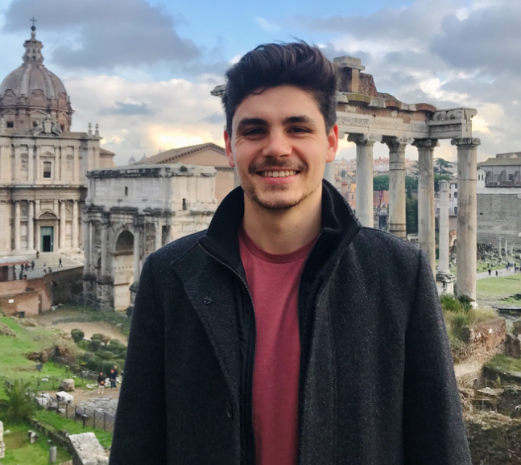
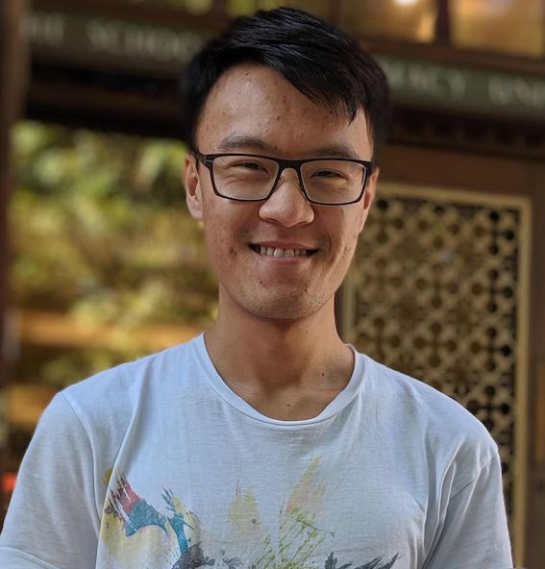
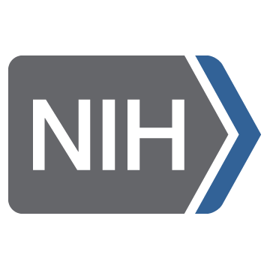
Some Viral People and Funders
UCL: Ed Tse, Tom Knight, Kangping Liu, Jemima Haque, Linda Patio, Robin Ketteler Chapel Hill: Tim Willson, Nat Moorman, Alex Tropsha, Konstantin Popov, Heba Agha, Peter Brown, Anwar Hossain Toronto: Cheryl Arrowsmith and team Diamond/Oxford: Joseph Newman Astex: James Day

